Slide 1
CoreDNS: A DNS Server for Kubernetes & Cloud Environments
Prepared by: Cricket Liu
Date: April 21, 2020

Slide 2
What Is a Container?
According to Docker: “A container is a standard unit of software that packages up code and all its dependencies so the application runs quickly and reliably from one computing environment to another. A Docker container image is a lightweight, standalone, executable package of software that includes everything needed to run an application: code, runtime, system tools, system libraries and settings.”
Think of a container as a lighter-weight virtual machine
Less computational overhead (because containers on a host share a kernel)
Smaller memory footprint (because containers use a union filesystem)
Notes:
Containers take advantage of features in a modern Linux kernel such as cgroups and namespaces to isolate applications running under a single OS
Containers also use a union filesystem so that each container can use different libraries, etc.
Union filesystems support layers, which are effectively diffs of a base filesystem
The base might be Ubuntu or CoreOS, while the layers add an application’s dependencies
Together, these mean that containers are much smaller than VMs, and much lighter-weight
Containers start in seconds, while VMs take minutes

Slide 3
What Is Kubernetes?
According to Wikipedia: An open-source container-orchestration system for automating application deployment, scaling, and management. It was originally designed by Google, and is now maintained by the Cloud Native Computing Foundation (CNCF). It aims to provide a "platform for automating deployment, scaling, and operations of application containers across clusters of hosts." It works with a range of container tools, including Docker.
Notes:
Kubernetes is driven by a declarative language that describes an application:
Which containers must be running to support the language, e.g., a database, an application engine, a UI engine…
Kubernetes also handles scaling, spinning up new containers to absorb increased workload
There used to be competing container orchestration systems, but Kubernetes won the day
(Google’s internal precursor to Kubernetes was Borg, so perhaps that’s no surprise)

Slide 4
Why Do Containers Care About DNS?
In containerized applications, containers need to locate and communicate with services running in other containers
For example, a container might need to locate a database service or an authorization service
Containerized environments support special calls that allow containers to locate services
But most developers prefer to use DNS
Because the library calls are relatively simple and well understood
Because it’s the way they’re accustomed to in traditional (i.e., non-containerized) environments
This function is supported by special DNS servers

Slide 5
DNS Servers for Docker
Docker and Kubernetes have had a succession of DNS servers that support this function
SkyDNS
SkyDNS2
KubeDNS
The newest is CoreDNS
An open source project, part of the Cloud Native Computing Foundation
Originally written by Miek Gieben, also the author of SkyDNS and SkyDNS2

Slide 6
A Brief History of CoreDNS
Miek wrote a popular DNS library in the Go language
Miek admired a Go-based web server called Caddy
Caddy is now a general-purpose server framework
Miek put the two together to create CoreDNS
CoreDNS inherited Caddy’s configuration syntax and plugin architecture
CoreDNS is now maintained by a team that includes many Infoblox employees

Slide 7
CoreDNS, Kubernetes and the CNCF
Google originally developed Kubernetes, then open-sourced it in 2015
To manage Kubernetes, Google partnered with The Linux Foundation to form the Cloud Native Computing Foundation, or CNCF
The CNCF is now the home of many open source technologies for creating cloud-native applications, including Prometheus and gRPC
CoreDNS was submitted to the CNCF in 2017 and “graduated” in 2019
CoreDNS is now the default DNS server shipped with Kubernetes and included with almost every new Kubernetes installation

Slide 8
CoreDNS: The Plugin Architecture
CoreDNS is based on plugins
Each plugin implements some piece of DNS functionality, e.g., caching or forwarding
Plugins can be chained to implement advanced functionality
CoreDNS currently supports 41 “in-tree” and 18 “external” plugins
Plugins are relatively easy to develop
And more are being developed all the time

Slide 9
A List of CoreDNS “In-Tree” Plugins
any
auto
autopath
azure
bind
cache
cancel
chaos
clouddns
debug
dnssec
dnstap
erratic
errors
etcd
file
forward
grpc
health
hosts
import
k8s_external
kubernetes
loadbalance
log
loop
metadata
prometheus
nsid
pprof
ready
reload
rewrite
root
route53
secondary
sign
template
tls
trace
whoami

Slide 10
Cloud CoreDNS Plugins
azure enables serving zone data from Microsoft Azure DNS service.
clouddns enables serving zone data from GCP Cloud DNS.
route53 enables serving zone data from AWS Route 53.
acl enforces access control policies based on source IP address and prevents unauthorized access to DNS servers.
forward facilitates proxying DNS messages to upstream resolvers.
firewall enables filtering of queries and responses based on expressions.

Slide 11
What Can You Do With CoreDNS?
Stitch together namespaces so you can resolve cloud and on-premises domain names from anywhere
Apply IP address- and type-based access controls
Using the firewall plugin, apply name resolution policies based on DNS message fields, or the Open Policy Agent (OPA)
including

Slide 12
The firewall Plugin
Apply configurable policy (allow, refuse, block or drop) based on many attributes of a DNS message:
type: type of the request (A, AAAA, TXT, ...)
name: name of the request (the domain name requested)
class: class of the request (IN, CH, ...)
proto: protocol used (tcp or udp)
client_ip: client's IP address, for IPv6 addresses these are enclosed in brackets: [::1]
size: request size in bytes
port: client's port
rcode: response CODE (NOERROR, NXDOMAIN, SERVFAIL, ...)
rsize: raw (uncompressed), response size (a client may receive a smaller response)
>rflags: response flags, each set flag will be displayed, e.g., "aa, tc". This includes the qr bit as well
>bufsize: the EDNS0 buffer size advertised in the query
>do: the EDNS0 DO (DNSSEC OK) bit set in the query
>id: query ID

Slide 13
The firewall Plugin (cont.)
>opcode: query OPCODE
server_ip: server's IP address; for IPv6 addresses these are enclosed in brackets: [::1]
server_port : client's port
response_ip : the IP address returned in the first A or AAAA record of the Answer section

Slide 14
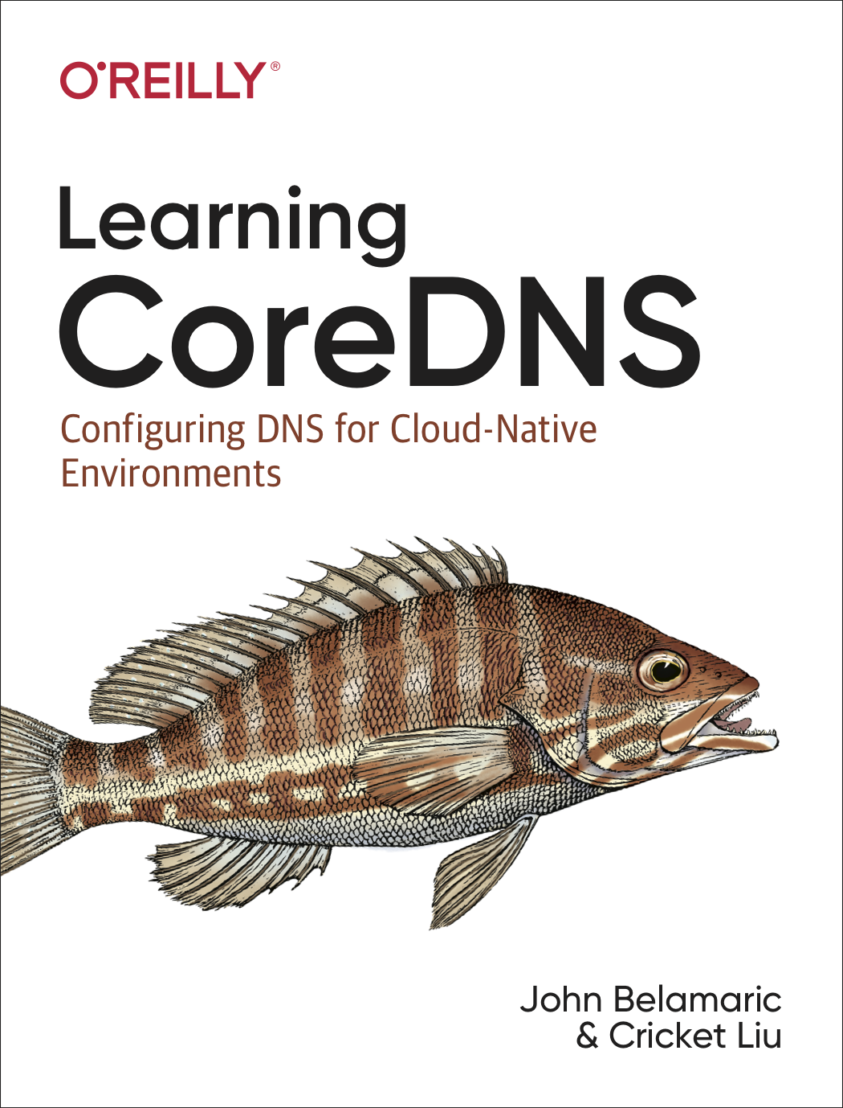
Learning More About CoreDNS
The CoreDNS web site, coredns.io
This excellent book

